Slide 1
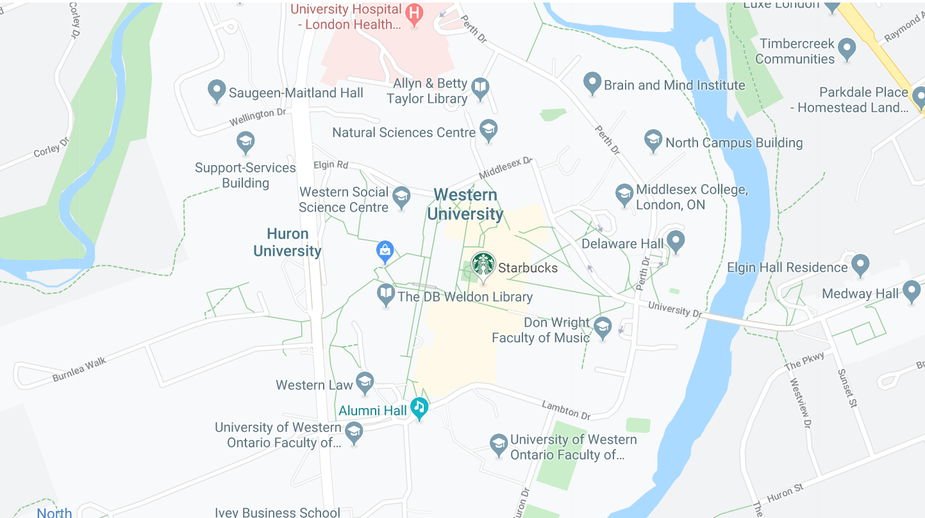










Access London
© 2019. M. Arnett, F. Khan, G. Kuznetsov, L. Stubson.

Slide 2
Select locations
Filters Options:
Accessible Doorway
Automatic Doorway
Entrance Ramp
Elevator
Accessible Parking
Wheelchair friendly service counter
Caution Filter
Legend:
Restaurants
Businesses
Public Spaces
Parks
Shops
Caution Zone
Rating Scale
1 2 3 4 5
View Type:
Map
Discover
Compare
00:00
12:00
6:00
18:00

Slide 3






Select locations
Filters Options:
Accessible Doorway
Automatic Doorway
Entrance Ramp
Elevator
Accessible Parking
Wheelchair friendly service counter
Caution Filter
Filters Options:
Accessible Doorway
Automatic Doorway
Entrance Ramp
Elevator
Accessible Parking
Wheelchair friendly service counter
Caution Filter
Legend:
Restaurants
Businesses
Public Spaces
Parks
Shops
Caution Zone
Rating Scale
1 2 3 4 5
View Type:
Map
Discover
Compare
00:00
12:00
6:00
18:00

Slide 4



Select locations
Don Wright Faculty of Music
Filters Options:
Accessible Doorway
Automatic Doorway
Entrance Ramp
Elevator
Accessible Parking
Wheelchair friendly service counter
Caution Filter
Accessible Washroom
Entrance Ramp
Elevator
Automatic Doorway
Opening Hours: ….
Rating Scale
1 2 3 4 5
View Type:
Map
Discover
Compare
00:00
12:00
6:00
18:00

Slide 5

Select locations
Don Wright Faculty of Music
Filters Options:
Accessible Doorway
Automatic Doorway
Entrance Ramp
Elevator
Accessible Parking
Wheelchair friendly service counter
Caution Filter
Accessible Washroom
Entrance Ramp
Elevator
Automatic Doorway
Opening Hours: ….
Rating Scale
1 2 3 4 5
View Type:
Map
Discover
Compare
00:00
12:00
6:00
18:00

Slide 6
Select locations
Don Wright Faculty of Music
Accessible Washroom
Entrance Ramp
Elevator
Automatic Doorway
Opening Hours: ….
View Type:
Map
Discover
Compare
00:00
12:00
6:00
18:00

Slide 7



Select locations
Don Wright Faculty of Music
Public Spaces
Parks
Filters Options:
Accessible Doorway
Automatic Doorway
Entrance Ramp
Elevator
Accessible Parking
Wheelchair friendly service counter
Caution Filter
500 M
1.0KM
1.5KM
2.0KM
Rating Scale
Shops
Businesses
1 2 3 4 5
View Type:
Map
Discover
Compare
Restaurants
00:00
12:00
6:00
18:00

Slide 8


Select locations
Don Wright Faculty of Music
Public Spaces
Parks
Filters Options:
Accessible Doorway
Automatic Doorway
Entrance Ramp
Elevator
Accessible Parking
Wheelchair friendly service counter
Caution Filter
500 M
1.0KM
1.5KM
2.0KM
Rating Scale
Shops
Businesses
1 2 3 4 5
View Type:
Map
Discover
Compare
Restaurants
00:00
12:00
6:00
18:00

Slide 9
Select locations
Don Wright Faculty of Music
Public Spaces
Parks
Filters Options:
Accessible Doorway
Automatic Doorway
Entrance Ramp
Elevator
Accessible Parking
Wheelchair friendly service counter
Caution Filter
500 M
1.0KM
1.5KM
2.0KM
Accessible Washroom
Entrance Ramp
Elevator
Automatic Doorway
Opening Hours: ….
Rating Scale
Shops
Businesses
1 2 3 4 5
View Type:
Map
Discover
Compare
Restaurants
00:00
12:00
6:00
18:00

Slide 10
Select locations
Don Wright Faculty of Music
Public Spaces
Parks
Filters Options:
Accessible Doorway
Automatic Doorway
Entrance Ramp
Elevator
Accessible Parking
Wheelchair friendly service counter
Caution Filter
500 M
1.0KM
1.5KM
2.0KM
Accessible Washroom
Entrance Ramp
Elevator
Automatic Doorway
Opening Hours: ….
Rating Scale
Shops
Businesses
1 2 3 4 5
View Type:
Map
Discover
Compare
Restaurants
00:00
12:00
6:00
18:00

Slide 11
Select locations
Don Wright Faculty of Music
Filters Options:
Accessible Doorway
Automatic Doorway
Entrance Ramp
Elevator
Accessible Parking
Wheelchair friendly service counter
Caution Filter
Accessible Washroom
Entrance Ramp
Elevator
Automatic Doorway
Opening Hours: ….
Rating Scale
1 2 3 4 5
View Type:
Map
Discover
Compare
00:00
12:00
6:00
18:00

Slide 12



Select locations
Filters Options:
Accessible Doorway
Automatic Doorway
Entrance Ramp
Elevator
Accessible Parking
Wheelchair friendly service counter
Caution Filter
Legend:
Restaurants
Businesses
Public Spaces
Parks
Shops
Caution Zone
Rating Scale
1 2 3 4 5
View Type:
Map
Discover
Compare
10:00
00:00
12:00
6:00
18:00

Slide 13




Select locations
Filters Options:
Accessible Doorway
Automatic Doorway
Entrance Ramp
Elevator
Accessible Parking
Wheelchair friendly service counter
Caution Filter
Legend:
Restaurants
Businesses
Public Spaces
Parks
Shops
Caution Zone
Rating Scale
1 2 3 4 5
View Type:
Map
Discover
Compare
15:40
00:00
12:00
6:00
18:00

Slide 14



Select locations
Filters Options:
Accessible Doorway
Automatic Doorway
Entrance Ramp
Elevator
Accessible Parking
Wheelchair friendly service counter
Caution Filter
Legend:
Restaurants
Businesses
Public Spaces
Parks
Shops
Caution Zone
Rating Scale
1 2 3 4 5
View Type:
Map
Discover
Compare
00:00
12:00
6:00
18:00

Slide 15

Compare locations
Western University
Fanshawe College
Downtown London
Within (Distance):
0.5 1 5 10 20 km
Public Spaces
Parks
Shops
Businesses
Restaurants
View Type:
Map
Discover
Compare

Slide 16
Compare locations
Western University
Fanshawe College
Downtown London
Within (Distance):
0.5 1 5 10 20 km
Public Spaces
Parks
Shops
Businesses
Restaurants
View Type:
Map
Discover
Compare

Slide 17
Compare locations
Western University
Fanshawe College
Downtown London
Within (Distance):
0.5 1 5 10 20 km
Public Spaces
Parks
Shops
Businesses
Restaurants
View Type:
Map
Discover
Compare

